Slide 1
Go Language Sharing
Bowen Chen
2016-11-21

Slide 2
Go History
Go originated as an experiment by Google engineers Robert Griesemer, Rob Pike, and Ken Thompson to design a new programming language that would resolve common criticisms of other languages while maintaining their positive characteristics. The new language was to:
be statically typed, scalable to large systems (as Java and C++).
be productive and readable, without too many mandatory keywords and repetition.
not require tooling, but support it well.
support networking and multiprocessing.
Go was announced in November 2009.
Go 1.0 was released in March 2012.
Go 1.5 was released in August 2015.
Go 1.7 was released in this year.

Slide 3
Go Basic
install(https://golang.org/doc/install)
workspaces(bin, pkg, src)
go tool(fmt build run get test…)
HelloWorld

Slide 4
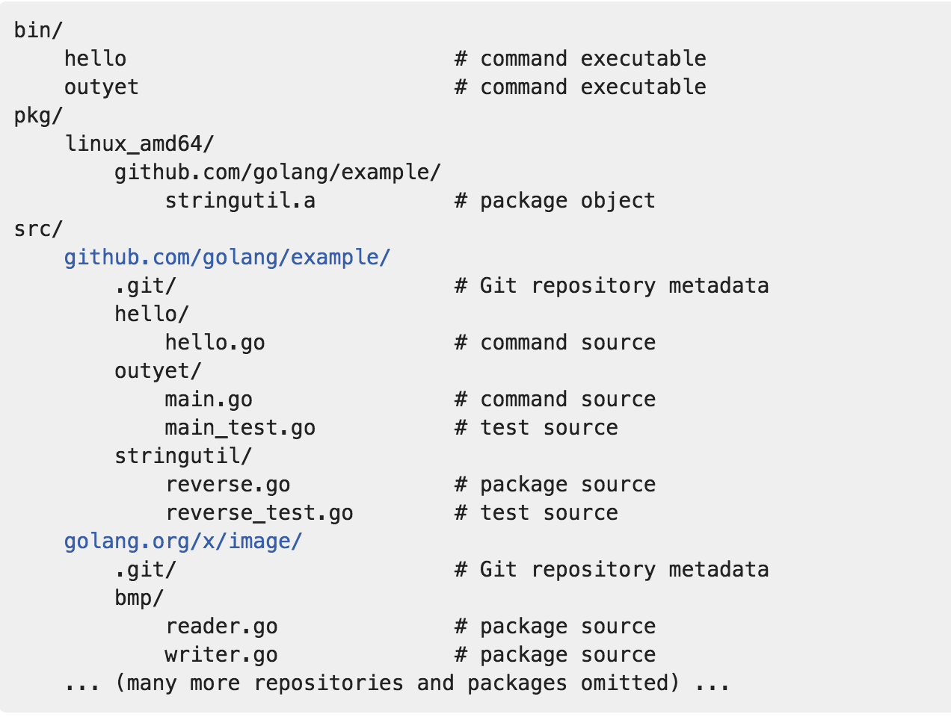

Slide 5
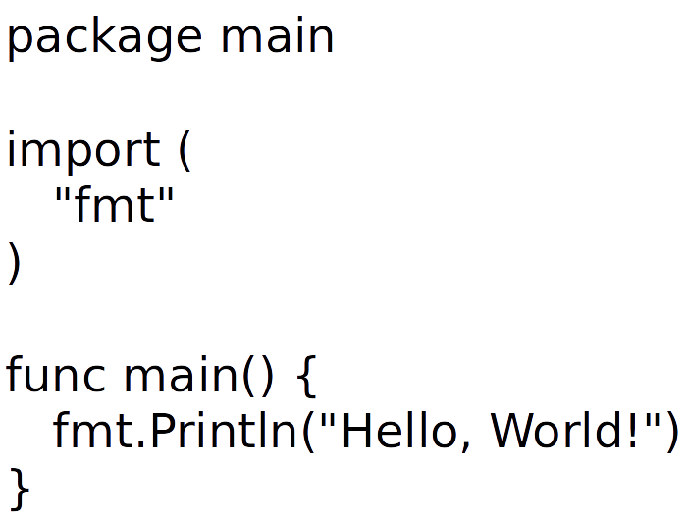

Slide 6
Go Variables And Types
Variables
A variable is a piece of storage containing a value.
var a int
a = 3
var a = 3
a := 3
Pointers
A pointer value is the address of a variable.
x := 1
p := &x
fmt.Println(*p) // "1"
*p = 2
fmt.Println(*p) // "2"

Slide 7
Types
basic data types
int8 int16 int32(rune) int64
uint8 uint16 unit32 unit64
float32 float64
complex64 complex128
var x complex128 = complex(1, 2)
bool
string
s := "hello, world"
fmt.Println(len(s))
fmt.Println(s[0], s[7]) // "104, 119" ('h' and 'w')
fmt.Println(s[0:5] // "hello"

Slide 8
Types
composite types
array
var a [3] int
fmt.Println(a[0])
slices
var x []int
x = append(x, 1)
x = append(x, 2, 3)
fmt.Println(x) // "[1, 2, 3]"
maps
var ages map[string]int
fmt.Println(ages == nil) // "true"
ages = make(map[string]int)
ages["bowen"] = 24

Slide 9
struct
type Point struct{ X, Y int }
p := Point{1, 2}
embedding and anonymous fields
type Circle struct {
Center Point
Radius int
}
type Circle struct {
Point
Radius int
}

Slide 10
Go Methods And Interfaces
Methods
Object is simply a value or variable that has methods,
and a method is a function associated with a particular type.
Interfaces
An interface is an abstract type, it reveals only some of their methods.
It specifies a set of methods that a concrete type must possess to be considered an instance of that interface.

Slide 11
declarations
package geometry
import "math"
type Point struct{ X, Y float64 }
// package-level function
func Distance(p, q Point) float64 {
return math.Hypot(q.X-p.X, q.Y-p.Y)
}
// method of type Point
func (p Point) Distance(q Point) float64 {
return math.Hypot(q.X-p.X, q.Y-p.Y)
}
p is called the method's receiver;
A common choice is the fisrt letter of the type name, like p for Point.

Slide 12
usage
p := Point{1, 2}
q := Point{4, 6}
fmt.Println(Distance(p, q)) // "5", function call
fmt.Println(p.Distance(q)) // "5", method call
With a pointer receiver
func (p *Point) ScaleBy(factor float64) {
p.X *= factor
p.Y *= factor
}

Slide 13
composition
declarations
import "image/color"
type ColoredPoint struct {
Point
Color color.RGBA
}
usage
red := color.RGBA{255, 0, 0, 255}
blue := color.RGBA{0, 0, 255, 255}
var p = ColoredPoint{Point{1, 1}, red}
var q = ColoredPoint{Point{5, 4}, blue}
fmt.Println(p.Distance(q.Point)) // "5"
p.ScaleBy(2)
q.ScaleBy(2)
fmt.Println(p.Distance(q.Point)) // "10"
encapsulation
type Point struct{ x, y float64 }

Slide 14
declarations
package io
type Writer interface {
Writer(p []byte) (n int, err error)
}
type Reader interface {
Read(p []byte) (n int, err error)
}
type Closer interface {
Close() error
}

Slide 15
interface satisfaction
A type statisfies an interface if it possesses all the methods the interface requires.
var w io.Writer
w = os.Stdout // ok
w = new(bytes.Buffer) // ok
w = time.Second // compile error
var any interface{}
any = true
any = 12.24
any = "hello"
any = new(bytes.Buffer)
any = time.Second

Slide 16
interface value
A value of an interface type has two components, a concrete type and a value of that type.
var w io.Writer
w = os.Stdout
w = new(bytes.Buffer)
w = nil
type assertions
A type assertion is an operation applied to an interface value.
x.(T)
type switchs
switch x.(type) {
case nil:
case int, unint:
case bool:
case string:
default:
}

Slide 17
Two stlyes of concurrent programming
CSP(communicating sequential process), a model of concurrency in which values are passed between independent activities(goroutines) but variables are for the most part confined to a single activity.
Mutual Exclusion, a approach is to allow many goroutines to access the variable, but only one at a time.

Slide 18
Goroutines
Each concurrently executing activity is called a goroutine.
now can assume a goroutine is similar to a thread.
main goroutine
created by the go statement
f() // call f(); wait for is to return
go f() // create a new goroutine that calls f(); don't wait

Slide 19
distinguish threads
stack
It's a work area where is saves the local variables of function calls that are in progress or temporarily suspended while another function is called.
growable stacks
OS thread has a fixed-size block of memory(often as large as 2MB) for its stack.
A goroutine starts life with a small stack, typically 2KB. Its not fixed, it grows and shrinks as needed.
goroutine scheduling
OS threads are scheduled by the OS kernel. Every few milliseconds, a hardware timer interrupts the processor, which causes a kernel function called the scheduler to be invoked.
a full context switch
The Go runtime contains its own scheduler that known as m:n scheduling (it multiplexes m goroutines on n OS threads, is analogous to the kernel scheduler).
the Go scheduler is not invoked periodically by a hardware timer, but implicitly by certain Go language constructs.
GOMAXPROCS is the n in m:n scheduling. It's default value is the number of CPUs on the machine.

Slide 20
Channels
A channel is a communication mechanism that lets one goroutine send values to another goroutine.
Each channel is a conduit for values of a particular type, called the channel's element type.
The type of a channle whose elements have type int is written chan int.
create a channel
ch := make(chan int) // ch has type 'chan int', unbuffered channel
ch := make(chan int, 3) // ch has type 'chan int' , buffered channel with capacity 3

Slide 21
operations
send and receive
ch <- x // a send statement
x = <-ch // a receive expression in an assignment statement
<-ch
close
close(ch)
A send operation on an unbuffered channel blocks the sending goroutine until another goroutine executes a corresponding receive on the same channel, at which point the value is transmitted and both goroutines may continue.
communication causes synchronize

Slide 22
A buffered channel has a queue of elements, a send operation on a buffered channel inserts an element at the back of the queue, and a receive operation removes an element from the front.
full will blocks
multiplexing with select
select {
case <-ch1:
// ...
case x := <-ch2:
// ...
case ch3 <- y:
// ...
default:
// ...
}
cancellation

